Slide 1

Construction managing system

Slide 2

Our client
Liron Hart -
Contractor

Slide 3
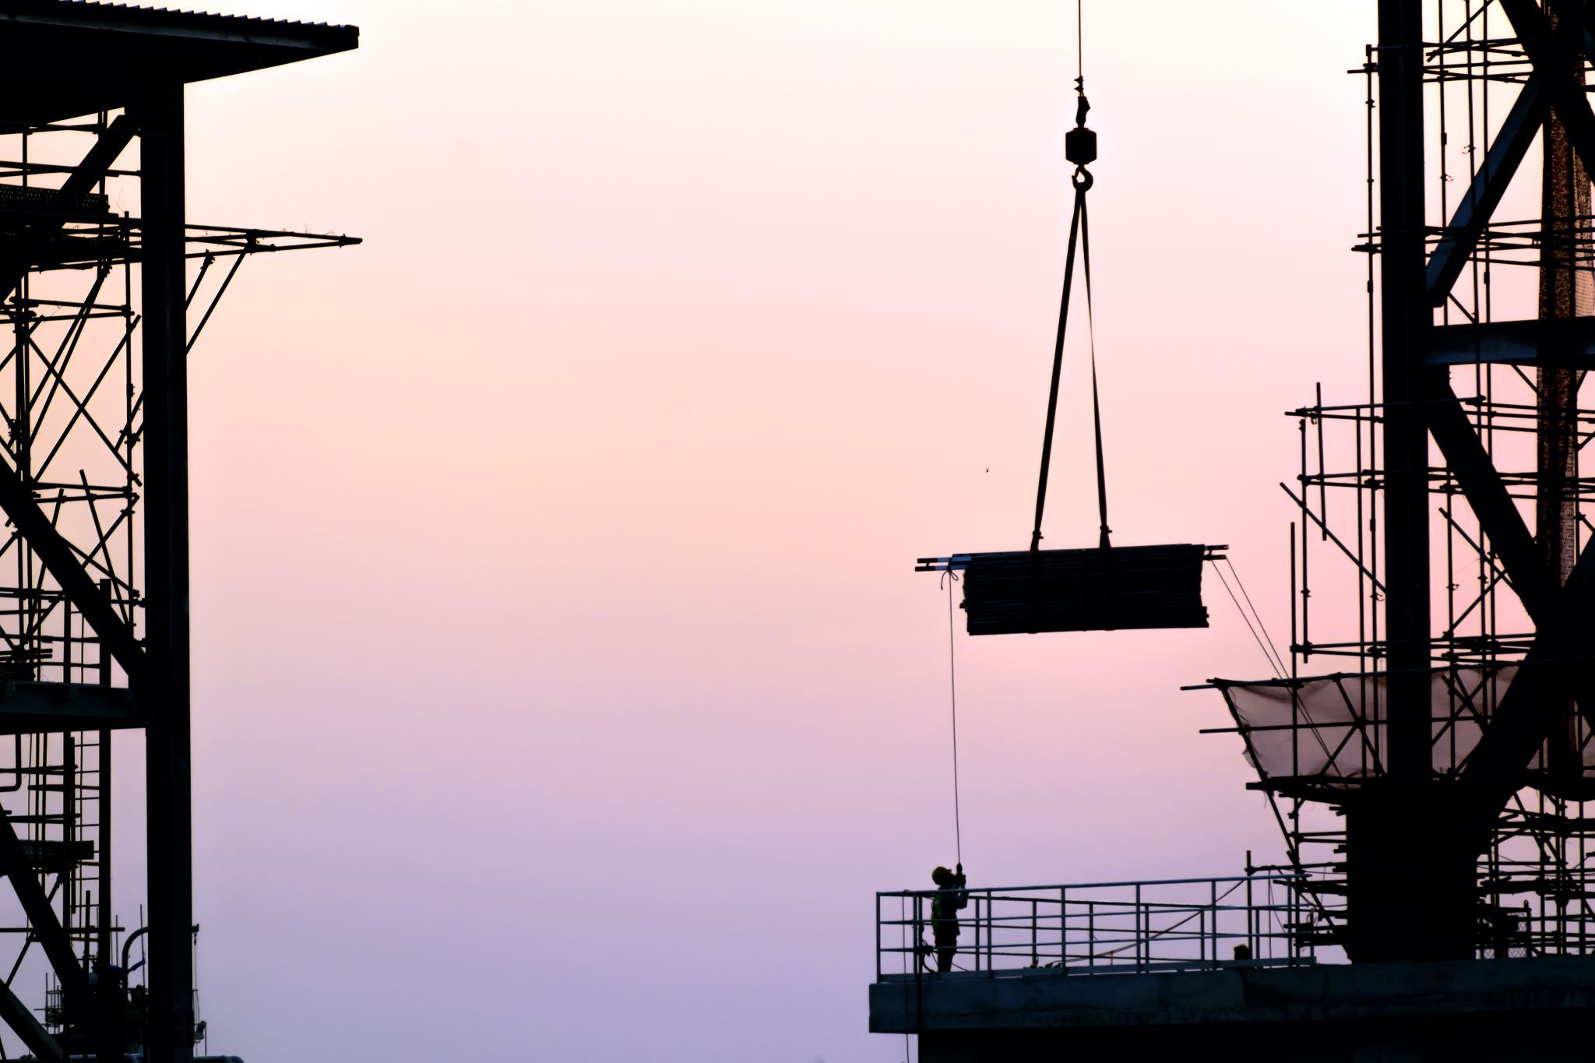

Problem Domain
Construction projects are complex processes that require tracking by the management.
Management can’t always be present in the field.
Sometimes proof of certain tasks are needed and asked for by the clients or authorities.
Reports are generated manually.

Slide 4
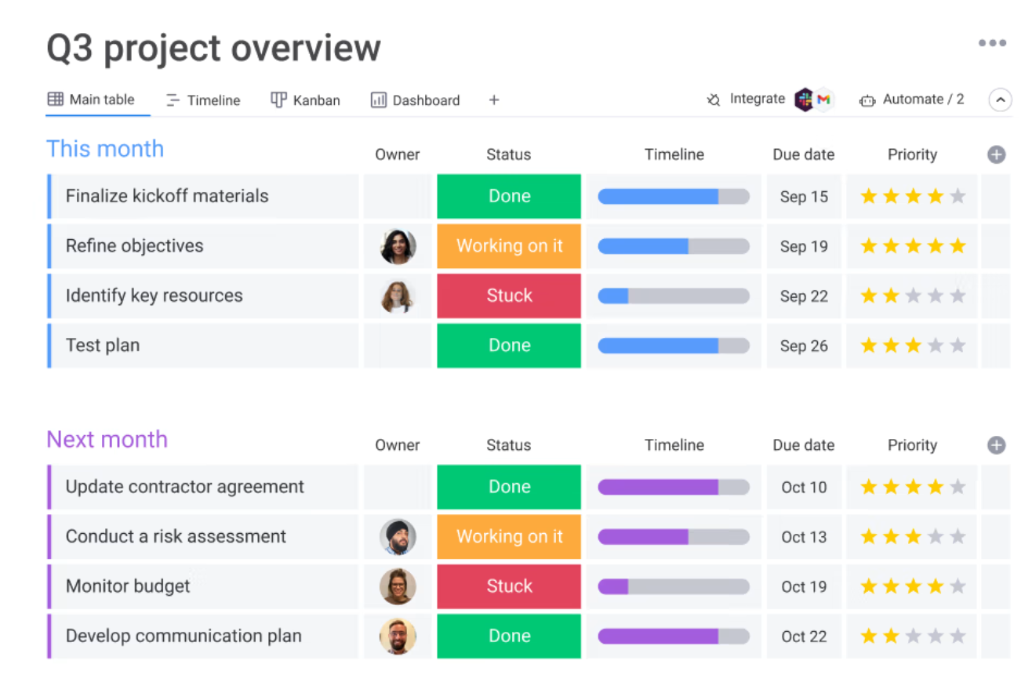

Today’s Market options
Monday – doesn’t allow generating the reports the managers need.
Conqum – not tailored enough to our costumer’s needs.
Wrike – doesn’t support text in Hebrew.
Any Kanban Board system – doesn’t support the reports and detailed documentation our client needs.

Slide 5

Our solution
Mobile application specifically tailored to our costumer’s needs.

